Slide 1


Artificial Intelligence 🡪 Information Security
COMP821 Information Security
Semester 1 2024

Slide 2
TOPICS
01
02
03
AI MODELS
AI FOR CYBER DEFENSE
AI FOR CYBER ATTACKS

Slide 3
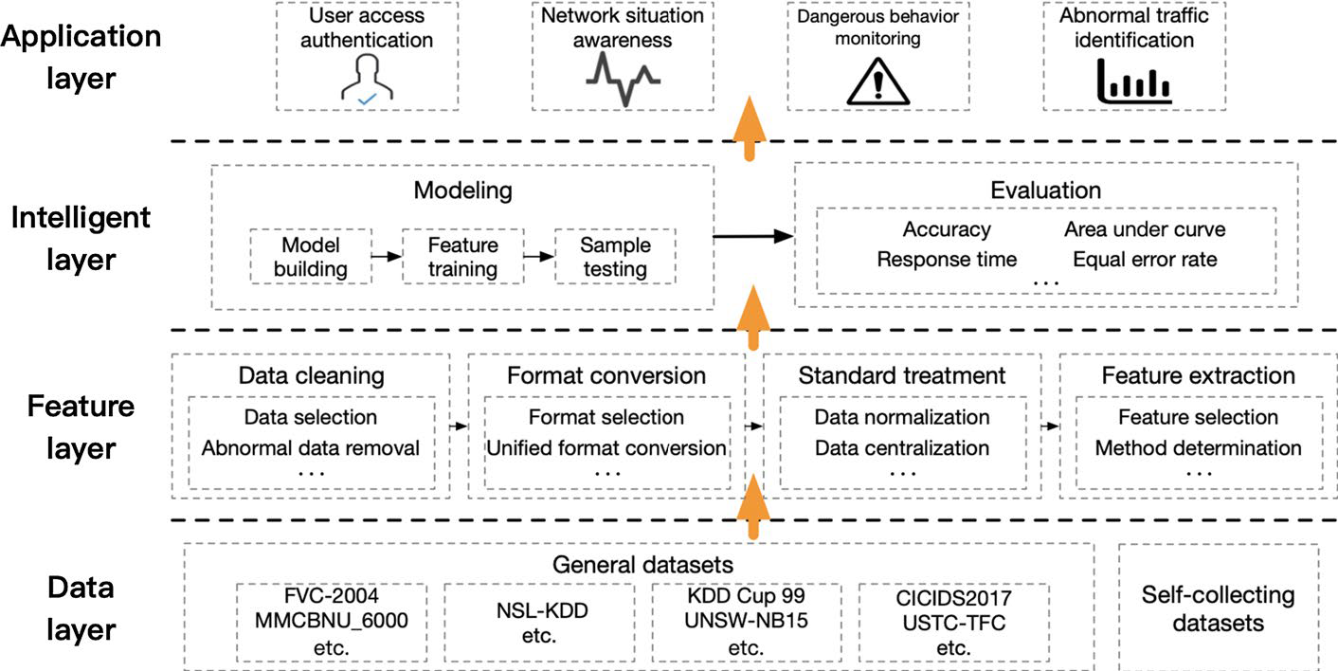
SOURCE 1 Zhang et al, 2022
Fig. 3 A general model for cyber security (using AI)

Slide 4
Limitations of AI approaches
Interference of confusing data (How much interference can cheat AI?)
Maliciously modified model
Lack of transparency in AI decision‑making process
High data requirements
------------------------------------------------------------------------------------------------------------------------------------------
Proposed Human-in-the-Loop Cyber Security Model (HLCSM). (Next slide)
MIM (manual intervention module) + MDM (machine detection module) --? When the confidence level is high, the final result will be given directly by MDM, which can not only save manpower, but also reduce the identification time and meet the requirements of cyber events processing. However, when the confidence level is low, the feedback will arrive at MIM and be processed by specialists

Slide 5
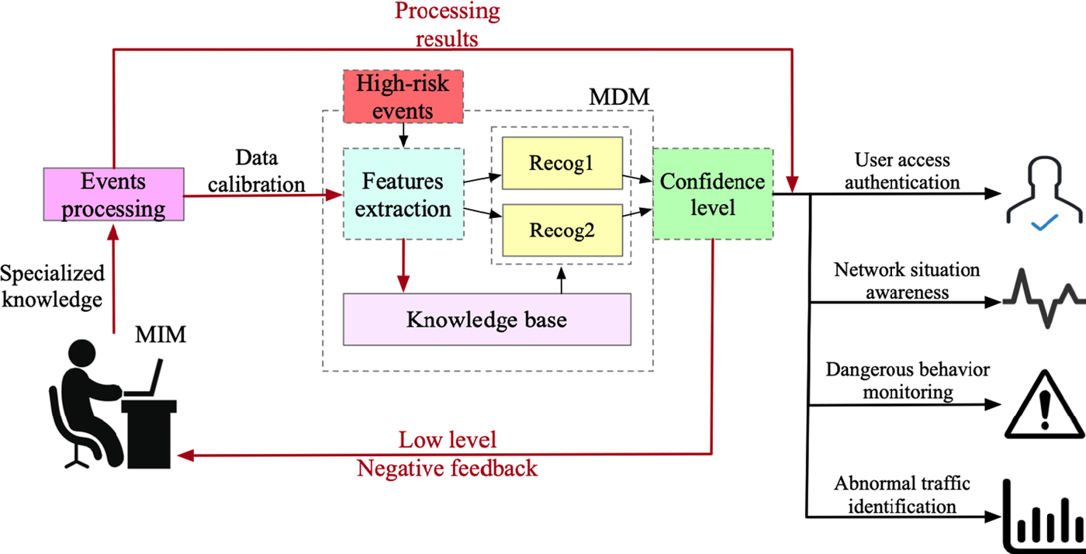

Slide 6
SOURCE 2 Kaur et al 2023: RQ2 -- use cases of AI in Cybersecurity
The term cybersecurity refers to a set of technologies, processes and practices to protect and defend networks, devices, software and data from attacks, damage or unauthorized access
AI: a tool that can provide analytics and intelligence to protect against ever-evolving cyberattacks by swiftly analysing millions of events and tracking a wide variety of cyber threats (definitions, sections 2.2)
to anticipate and act in advance of the problem.
AI is increasingly being integrated into the cybersecurity fabric
used in a variety of use cases to automate security tasks or support the work of human security teams

Slide 7
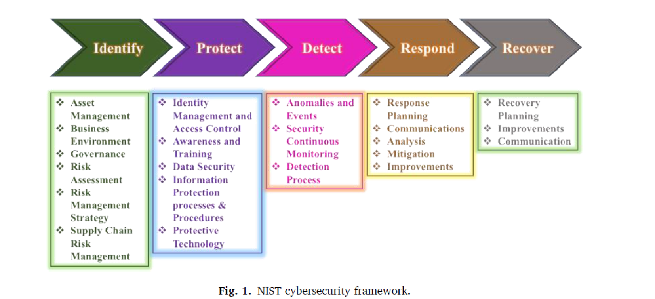
Applying the NIST Cybersecurity Framework
AI techniques in the five different cybersecurity functions (Identify, Protect, Detect, Respond and Recover)

Slide 8
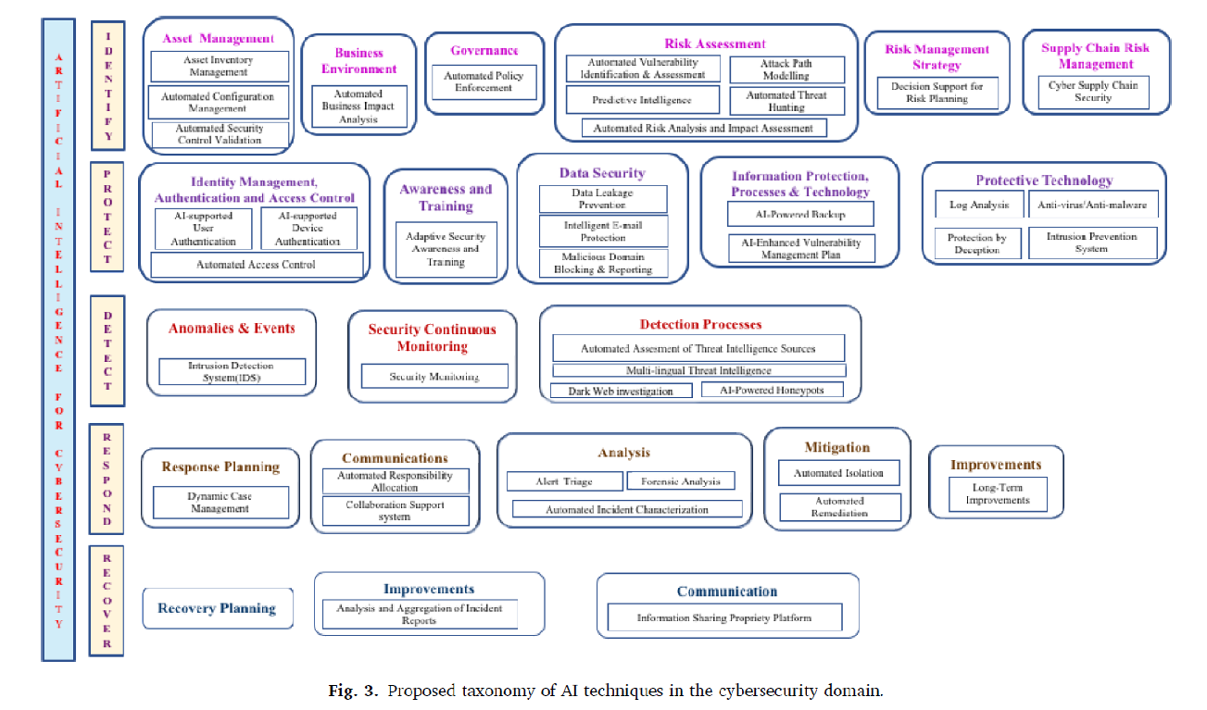

Slide 9
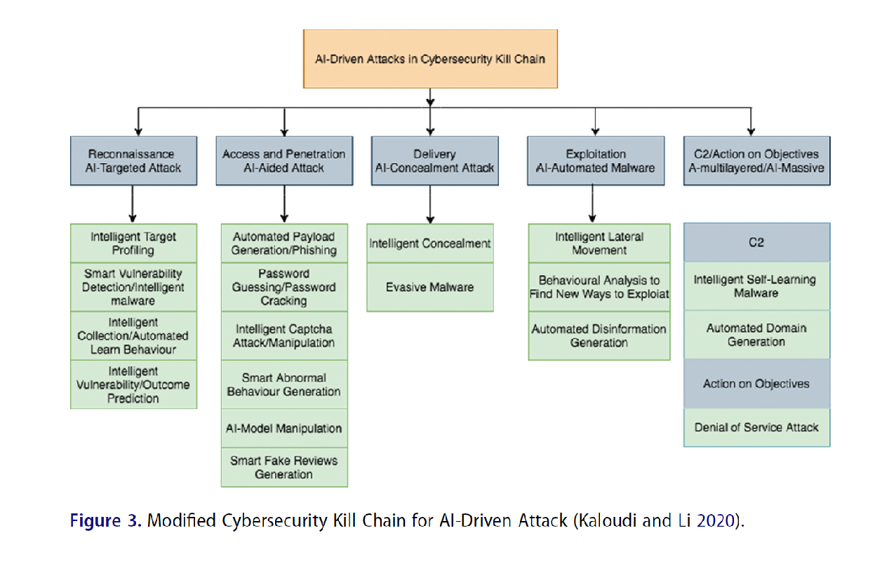
SOURCE 3 Guembe et al 2022

Slide 10
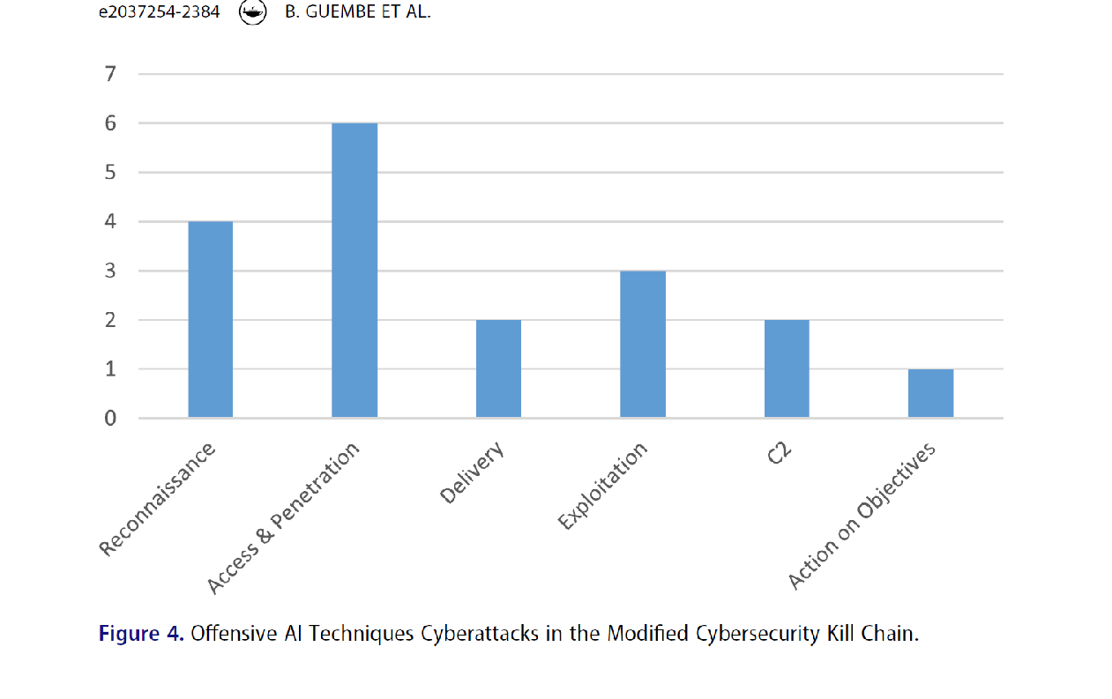

Slide 11
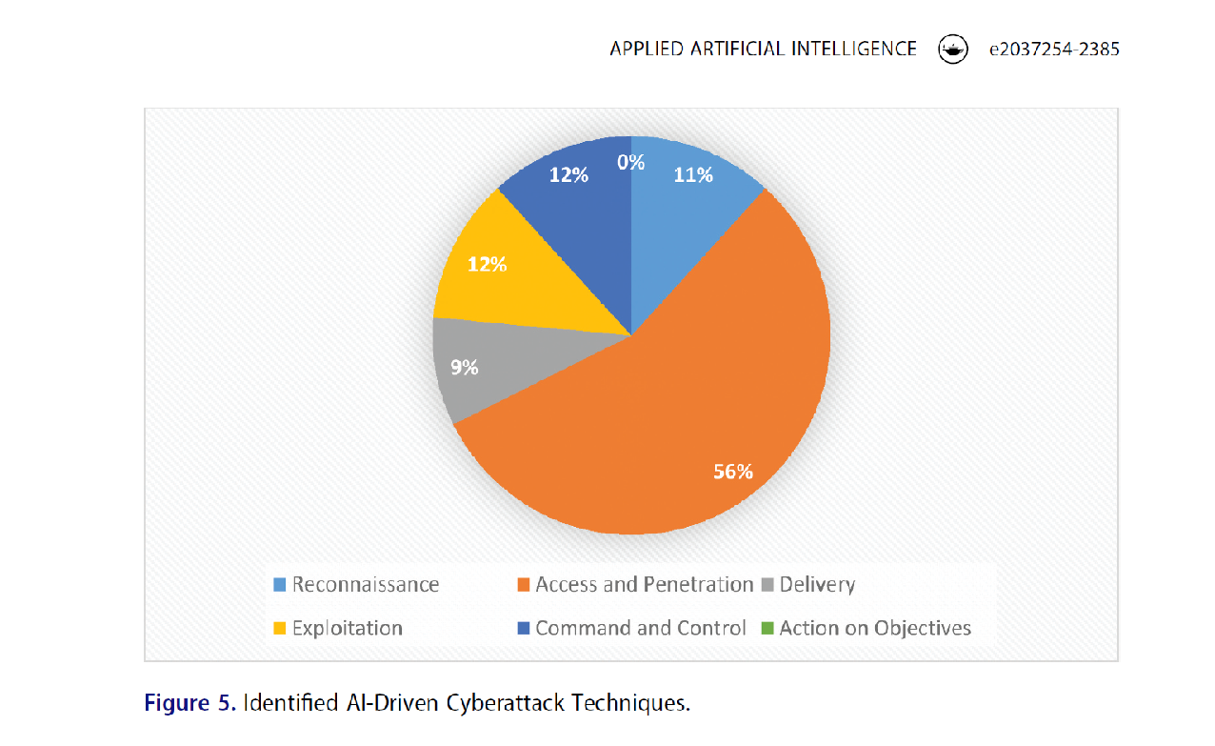

Slide 12
SOURCE 4 de Azambuja et al, 2023: AI -based cyber-attacks
Industry 4.0: Technological development paves the way for intelligent factories with machines based on automated and digitized manufacturing systems. ….. interconnection of the physical and technological environment , remote data processing
Cyber-physical systems: networked physical processes integrated with cybernetic components, sensors, and actuators, which interact in a process monitoring cycle, providing information for decision-making in the production line

Slide 13
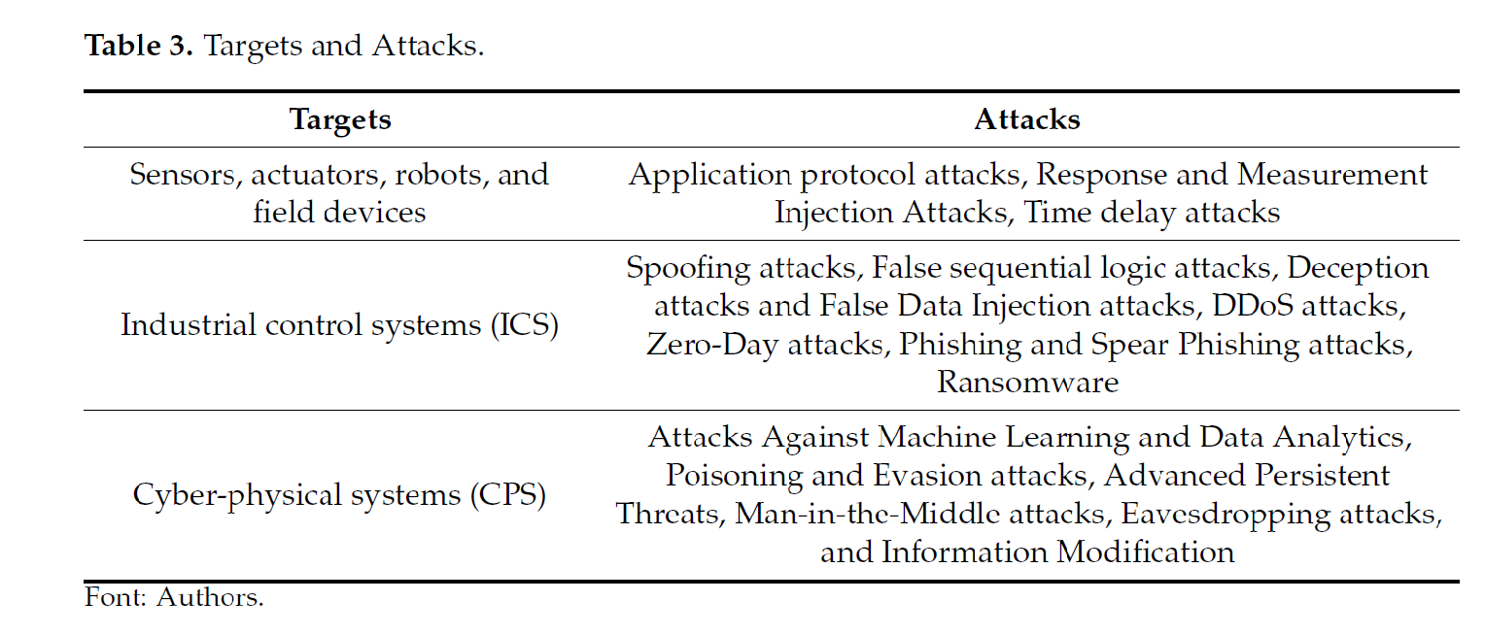
Industry 4.0: Targets and attacks

Slide 14
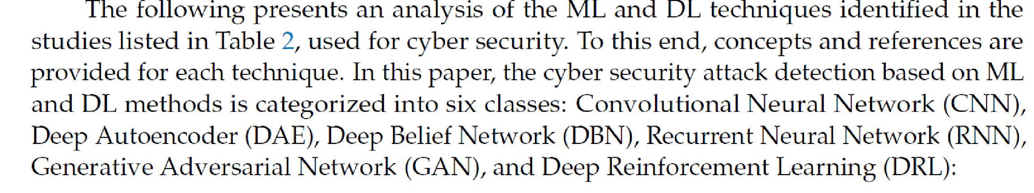
NN approaches for cyber security

Slide 15
SOURCE 5 Ali et al, 2023 SECTION III.THE USE OF ARTIFICIAL INTELLIGENCE BY CYBER ATTACKERS
A. Tools for Deepfakes: create or manipulate visual and audio content to appear authentic
B. Artificial Intelligence-Supported Password Guessing
C. Impersonation Of Humans On Social Media Platforms
D. Tools for Artificial Intelligence Supported Hacks

Slide 16
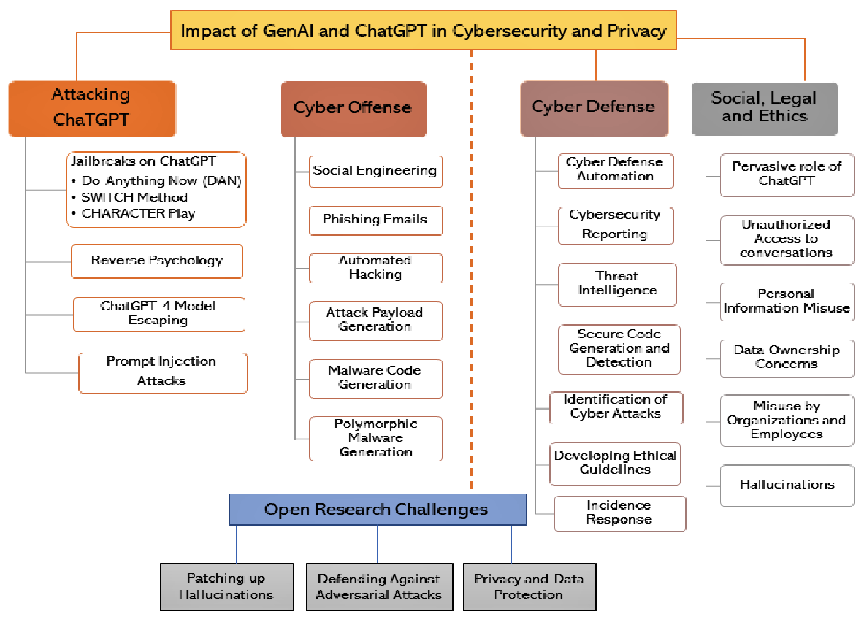
SOURCE 6 Gupta et al 2023
FIGURE 3. A roadmap of GenAI and ChatGPT in Cybersecurity and privacy

Slide 17
Successful attacks on ChatGPT– examples
Jailbreaking: making ChatGPT to respond beyond OpenAI’s internal governance and ethics policies , by inserting specific prompts. Methods: Do anything now (DAN), SWITCH, Character play, others. Leads to the generation of harmful content, the spreading of disinformation, and other malevolent uses of AI.
Reverse psychology: exploiting the AI model’s natural tendency to correct inaccuracies. E.g., ChatGPT initially refuses to give the list of websites for downloading pirated. With the psychological reversal of the question, ChatGPT gives the desired response.
Prompt injection – to force revealing information not intended for the user,

Slide 18
ChatGPT FOR CYBER OFFENSE
Social Engineering and Phishing
Automated hacking
Attack payload generation : e.g., an he attacker could train ChatGPT on SQL syntax and techniques commonly used in injection attacks, and then provide it with specific details of the target system. Subsequently, ChatGPT could be utilized to generate an SQL payload for injection into the vulnerable system.
Ransomware and malware code generation
Viruses to attack CPU architecture. Polymorphic malware (changes code after execution to circumvent defence)

Slide 19
ChatGPT for Cyber Defence
Reducing the workload of Security Analysts by automatically analyzing cybersecurity incidents
As an AI language model, ChatGPT can assist in cybersecurity reporting by generating natural language reports based on cybersecurity data and events
Threat Intelligence: processing vast amounts of data to identify potential security threats and generate actionable intelligence
Secure code generation and detection
Identifying cyber attacks by generating natural language descriptions of attack patterns and behaviors
…………..others

